Slide 1
Early Childhood Education and Care policy: Systems analysis and marketisation
ED7414 – Week 8
Professor Eva Lloyd’s slides
Delivered by Dr Jenny Robson with some additional slides
Monday 14 November 2019

Slide 2
Learning outcomes for today
Apply systems theory and theoretical perspectives on marketisation to critically examine policy and its implementation (LO4 and LO6).
Critically reflect on how ECEC policy in the UK context (e.g. 30 hours for working parents, 15 hours for disadvantaged two year olds) affects children, parents and practitioners (LO3, LO1)

Slide 3
Outline of presentation
What is an early childhood system?
How to deliver quality, equitable and sustainable services for young children?
Marketised early childhood service systems
Alternative models: beyond markets

Slide 4
Systems Theory – introduction and applying the theory
Part 1

Slide 5
Discussion Point
What is the English ECEC system for children aged 0 to 5 as determined by government policy?
Focus on understanding complexity, component parts, relationships and characteristics of the system.

Slide 6
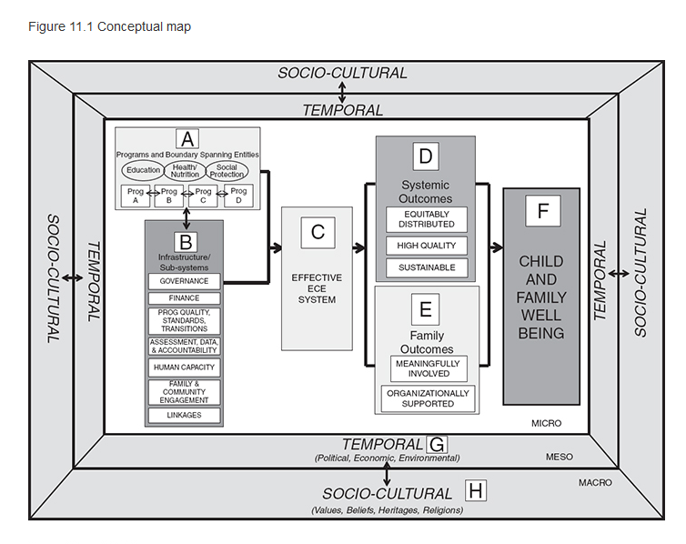
A conceptual map of the Early Childhood Education system (Kagan, 2016)

Slide 7
What is systems theory?
...systems theory is a paradigmatic perspective that views all phenomena as a web of relationships among elements, a system...It suggests that all systems, whether social, biological, or even electrical, share common properties and patterns of interactions that can be examined to better understand complex phenomena. In examining regularly interacting elements (laws, models, principles, activities, institutions, people), systems theory suggests that individual parts cannot be fully understood when they are separated from the whole
(Kagan et al, 2016, p. 163)

Slide 8
Applying systems theory in early childhood research
Systems theory generally, and new institutional theory specifically, differ from conventional thinking in that they are concerned with multiple institutions and phenomena including the laws, policies, regulations, guidelines, and institutional structures that shape the nature of services offered to young children and their families
(Kagan et al, 2016: 164)

Slide 9
What is new institutional theory?
...new institutional theory stresses the fundamental role that institutions play in shaping the delivery of services... institutional theory allows us to examine child and family outcomes from the stance that they may accrue not only as a result of what children, families, and early childhood teachers do, but as a partial result of a complex (and somewhat understudied) array of changing policies, non-familial institutions, and contexts.
(Kagan et al, 2016: 164)

Slide 10
Equity, quality and sustainability: macro level ECEC system outcomes
Three macro-level system outcomes that transcend and influence child and family outcomes (Kagan, 2015).
the quality of services and supports,
their equitable distribution,
(iii) their sustainability over time essential pre-requisites for successful child and family outcomes.
‘As such, they become a focus for our analysis and, potentially, for other analyses of early childhood systems.’ (Kagan et al, 2016: 165)

Slide 11
Points for reflection:
As we consider the system level outcomes consider whether the English ECEC system achieves these system level outcomes?

Slide 12
Systems theory and equity
The way in which a country regards its obligation to young children is embedded in its socio-cultural history, defining not only what services should be delivered, but also how and to whom they are delivered (Kagan et al, 2016: 170)
Equitable access to services
Equitable distribution of budgets
Equitable distribution and remuneration of personnel
(Kagan et al, 2016: 173)

Slide 13
Systems theory and quality
...programmatic expansions that simply build on a dysfunctional structure are unlikely to produce significant gains for quality, much less for the equitable distribution of services or for their sustainability (Kagan et al, 2016: 165)
Quantity and quality
Pedagogical frameworks and standards
Meaningful professional preparation and development
(Kagan et al, 2016: 176)

Slide 14
Systems theory and sustainability
...if scholars continue to produce the same kinds of research on the same topics, there is likely to be little improvement in the way ECE is conceptualized and delivered. There is a need for new thinking about how quality is produced, how services can be more equitably distributed, and how societies can prevent the ‘here-today, gone-tomorrow’ approach to ECE policies (Kagan et al, 2016: 165).
Financing and sustainability
Data/accountability systems and sustainability
Political/public support and sustainability
(Kagan et al, 2016: 178)

Slide 15
UK early childhood system challenges
Systemic differences between the 4 jurisdictions making up the UK
Split governance responsibilities between a range of Central Government agencies
Splits between childcare and early education policies
Splits within the early childhood workforce in terms of qualifications, CPD and employment terms and conditions
A complex mixed market economy of early childhood education and care (Lloyd, 2019)

Slide 16
Childcare markets
Part 2

Slide 17
Discussion Point
What is a childcare market?
How does it operate?
What are your perspectives on the childcare market?

Slide 18
What is a childcare market?
Many early childhood service systems include both private (for-profit and not-for-profit) and state funded provision
This is called a mixed economy of childcare or childcare market
Parents may receive state support to buy in this market, through tax credits or vouchers, i.e. via demand-side subsidies
Early education may be part of this market or not
Childcare markets predominate in English speaking countries (Lloyd, 2012a)

Slide 19
Why have a childcare market?
Governments promote childcare markets in the belief that they encourage business efficiency while extending consumer choice (Plantenga and Remery, 2009)
In the present global economic climate childcare markets are a rapidly growing phenomenon
(Lloyd, 2019)
Some markets are ‘raw’ markets, with minimal or no government intervention, mostly in poor countries (Penn, 2012: 173)

Slide 20
Childcare markets as atypical markets
Childcare is not like other goods and services. Its inherent nature creates unusual challenges for efficient delivery by the market, while its usage can have social as well as private consequences. Government involvement in childcare may therefore be justified to improve the efficiency of delivery or achieve social objectives, but its effectiveness will depend on whether policy measures can better address the challenges of childcare provision than the market.
(Paull, 2014, p. 14)

Slide 21
Childcare market risks
Marketisation and privatisation, including corporatisation, risk deepening, consolidating or widening inequalities of access to ECEC
(Lloyd, 2012a; Lloyd and Penn, 2014)
Developments in English and Dutch childcare markets illustrate a failure to create incentives to offer consumers more choice and competitive pricing (Lloyd and Penn, 2014)
Marketisation and privatisation may drive up costs and promote qualitative differences between provider types
(Penn and Lloyd, 2013)

Slide 22
Mitigating childcare market risks
Policy interventions by governments, e.g. parental fee capping; stringent quality regulation; improved workforce conditions
An enhanced role for childcare businesses with governance structures reflecting clearly articulated values and principles, like social enterprises or co-operatives
National debates with wide range of stakeholders to agree values and principles underpinning the systems
(Lloyd, 2019; Penn and Lloyd, 2014)

Slide 23
Market models and equity: a challenge to research
The way in which state support is allocated between parents and ECEC providers may lead to differences in impact on different population groups, with disadvantaged children at risk of losing out. But very few studies place their findings within their wider policy context, for instance examining the delivery mechanisms’ impact on service quality and hence impact.
(Lloyd and Potter, 2014: 80)

Slide 24
Discussion point – consider the English perspective
To what extent can childcare markets promote equity in early years education and childcare?
Are primary guiding principles of competition and individual choice appropriate values in this area of provision?
What might be seen as feasible alternatives to childcare markets? To what extent are such alternatives compatible with wider government policy objectives in England and the UK as a whole?
(Lloyd, 2019; Lloyd and Penn, 2012)

Slide 25
References
Bronfenbrenner, U. (1979) The ecology of human development: experiments by nature and design. Cambridge, MA: Harvard University Press
Kagan, S. L. (2015) ‘Conceptualizing ECE governance: Not the elephant in the room.’ In S. L. Kagan and R. E. Gomez (eds), Early childhood governance: Choices and consequences (pp. 9–29). New York: Teachers College Press
Kagan, S.L., Araujo, M.C., Jaimovich, A. and Aguayo, Y.C. (2016) 'Understanding systems theory and thinking: early childhood education in Latin America and the Caribbean', in A. Farrell, S.L. Kagan and E. K.M. Tisdall (Eds.) The SAGE Handbook of Early Childhood Research. Sage Publications Ltd (UK) Chapter 11
Lloyd, E. (2012a) ‘The marketisation of early years education and care in England’, in Miller, L. and Hevey, D. (eds.) Policy issues in the early years, London: SAGE,107-121

Slide 26
References
Lloyd, E.(2019) ‘Reshaping and reimagining marketised early childhood education and care systems: challenges and possibilities’, Zeitschrift für Pädagogik, 65(3), 89-106
Lloyd, E. and Penn, H. (eds.) (2012) Childcare markets – Can they deliver an equitable service? Bristol and Chicago: Policy Press
Lloyd, E. and Penn, H. (2014) ‘Childcare markets in an age of austerity,’ European Early Childhood Education Research Journal, 22 (3), 386-396
Lloyd, E. and Potter, S. (2014) Early education and childcare and poverty - Working paper prepared for the Joseph Rowntree Foundation. London: UEL http://roar.uel.ac.uk/3865/
Moss, P. (2017) 'Power and resistance in early childhood education: From dominant discourse to democratic experimentalism', Journal of Pedagogy 8 (1), 11 - 32
Paull, G. (2014) ‘Can government intervention in childcare be justified?’ Economic Affairs, 34 (1), 14-34

Slide 27
References
Penn. H. and Lloyd, E. (2013) The costs of childcare. A report for DFE. London: Childhood Wellbeing Research Centre. Available from: http://www.cwrc.ac.uk/projects/documents/CostsofchildcareJuly2013.pdf
Penn, H. and Lloyd, E. (2014) ‘How can government ensure that early childhood care and education is of high quality? A review of the international evidence,’ in Wolfe, T. (Ed) Childcare – Business or profession? Dublin: Start Strong. Available from: http://www.startstrong.ie/files/Childcare_Business_or_Profession_Full_Report_Web_Version.pdf
Plantenga, J. and Remery, C. (2009) The provision of childcare services. Brussels: European Commission

